Slide 1
Session 1 Rotary Branding
Rotary Branding – PDG Pete Booker

Slide 2
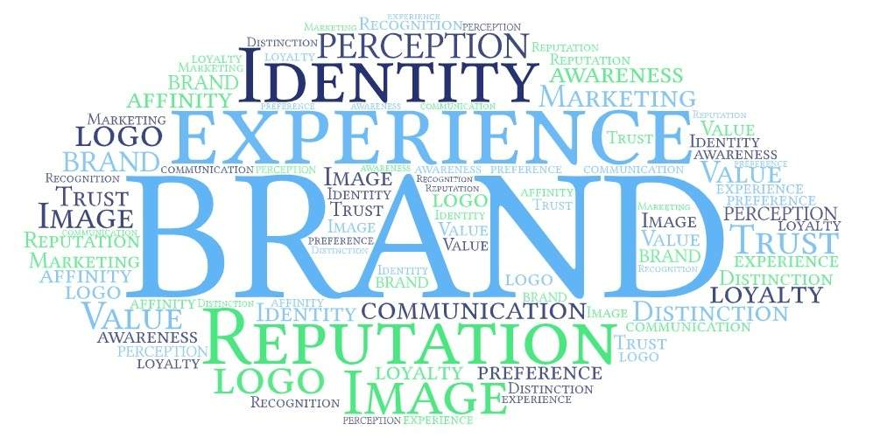
Notes:
You may think of a brand as simply a product — for example, the kind of rice or bread or coffee you buy. Or you may think of a brand as a logo and advertising slogans. So when you think of Rotary's brand, you may think of our name and wheel.

Slide 3
Notes:
It's true that logos visually communicate an organization's brand. But a brand is more than its logos. Rotary's brand is much bigger than its wheel.
So what else is a brand?

Slide 4
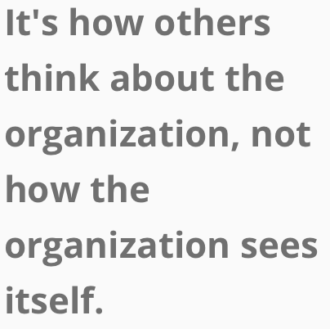
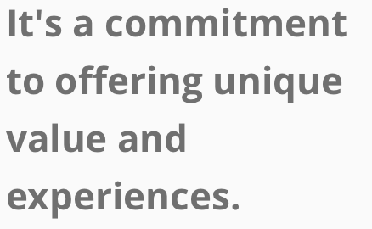
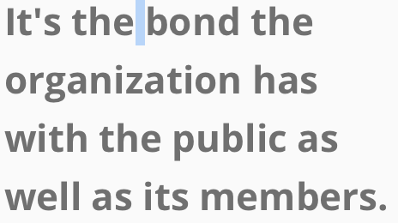
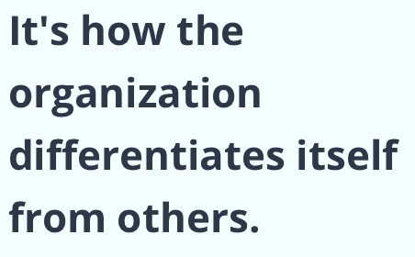
Perception
AN EMOTIONAL CONNECTION
A PROMISE
A RECOGNIZABLE LOGO
A DISTINCT CONCEPT
Used consistently and
repeatedly, it provides instant recognition and understanding.
Notes:
Read screen.

Slide 5
ROTARY’S BRAND
Perception
AN EMOTIONAL CONNECTION
A PROMISE
Rotary is an organization committed to using our connections, experience and skills to work together to create lasting change.
Rotary joins leaders from all continents, cultures to exchange ideas and take action to. create lasting change in our communities.
Rotary and Rotaract clubs work with their communities to develop trust and create bonds so that people want to join, donate, volunteer or work with us.
A RECOGNIZABLE LOGO
A DISTINCT CONCEPT
Rotary uses the diverse perspectives of our 1.4 million members to solve the world’s most challenging problems.
People become aware of who we are and what we do when clubs consistently and correctly use
our logos and templates.
Notes:
Read screen.

Slide 6
Notes:
McDonald’s has created a brand that’s recognized worldwide. And because all of its restaurants use the McDonald’s brand correctly, they benefit from this recognition too.
Similarly, each Rotary and Rotaract club benefits when we all consistently and correctly use Rotary’s logos, fonts, colors, and photography to strengthen our brand.
Here’s how a strong brand helps your club

Slide 7
It expands peoples’ understanding of what Rotary does.
It increases membership, partnerships, volunteers and donors.
It helps Rotary get noticed.
It inspires current members.
It helps Rotary expand our reach.
Notes:
When people in your community understand what Rotary does, they’ll be more interested in being a part of your club.
The more we do, the bigger the impact we make in our communities and around the world.
When people recognize our brand and understand Rotary’s impact, they appreciate the unique opportunity to make a difference that our clubs offer them.
When members are recognized for the work that Rotary accomplishes, they feel proud and are energized to take more action in their clubs and communities.
When people know who we are, what we do, and why it’s worth their time, we can achieve Rotary's vision.

Slide 8
How you can strengthen Rotary's brand…
Notes:
People's perception of Rotary comes from their experiences with our clubs and programs, along with the stories we tell and the images we share. It’s every member’s responsibility to help strengthen Rotary's brand.

Slide 9
A few thoughts to consider…
Your should be able to communicate your brand easily and consistently.
Can you tell someone what your brand stands for?
Before anything else make them aware. Be first, or be better.
Plan for your “customer’s” understanding and fulfillment of ROI.
How do you repeat your brand experience and build value.
Can you repair a damaged brand?
Notes:
Can you provide one word that accurately describes your club, RI, your experience as a Rotarian?
Each person’s perception of brand is based on what it does for him or her.
You need a plan and resources to build and reinforce your brand.
For a brand to be consistently successful, you have to live it and execute on it.
To fix it, first get the outside world’s feed back on WHY they are not interested or have a dim view, then build a plan to address the most important core issues that affect a broad audience.

Slide 10
Exercise… Let’s bring it home!
Answer these questions in your group and be prepared to share with the multitudes…
What does value mean for Rotary (why are you a Rotarian, how are we perceived?)
What is the value proposition in my Rotary club – Local and RI?
Does my club have a brand – and does it live up to that statement?
Consider an amalgam of all the clubs in your group – create a value proposition and a brand statement. Be prepared to explain what that brand stands for and how your club will deliver on it. How will everything you do reinforce positive perception?
What is one thing will you take back to your club to help establish and/or build your brand?
Notes:
Read screen

Slide 11
Exercise… Let’s bring it home!
Answer these questions in your group and be prepared to share with the multitudes…
What does value mean for Rotary (why are you a Rotarian, how are we perceived?)
What is the value proposition in my Rotary club – Local and RI?
Does my club have a brand – and does it live up to that statement?
Consider an amalgam of all the clubs in your group – create a value proposition and a brand statement. Be prepared to explain what that brand stands for and how your club will deliver on it. How will everything you do reinforce positive perception?
What is one thing will you take back to your club to help establish and/or build your brand?
Notes:
Read screen

Slide 12
Exercise… Let’s bring it home!
Answer these questions in your group and be prepared to share with the multitudes…
What does value mean for Rotary (why are you a Rotarian, how are we perceived?)
What is the value proposition in my Rotary club – Local and RI?
Does my club have a brand – and does it live up to that statement?
Consider an amalgam of all the clubs in your group – create a value proposition and a brand statement. Be prepared to explain what that brand stands for and how your club will deliver on it. How will everything you do reinforce positive perception?
What is one thing will you take back to your club to help establish and/or build your brand?
Notes:
Read screen

Slide 13
Exercise… Let’s bring it home!
Answer these questions in your group and be prepared to share with the multitudes…
What does value mean for Rotary (why are you a Rotarian, how are we perceived?)
What is the value proposition in my Rotary club – Local and RI?
Does my club have a brand – and does it live up to that statement?
Consider an amalgam of all the clubs in your group – create a value proposition and a brand statement. Be prepared to explain what that brand stands for and how your club will deliver on it. How will everything you do reinforce positive perception?
What is one thing will you take back to your club to help establish and/or build your brand?
Notes:
Read screen

Slide 14
Exercise… Let’s bring it home!
Answer these questions in your group and be prepared to share with the multitudes…
What does value mean for Rotary (why are you a Rotarian, how are we perceived?)
What is the value proposition in my Rotary club – Local and RI?
Does my club have a brand – and does it live up to that statement?
Consider an amalgam of all the clubs in your group – create a value proposition and a brand statement. Be prepared to explain what that brand stands for and how your club will deliver on it. How will everything you do reinforce positive perception?
What is one thing will you take back to your club to help establish and/or build your brand?
Notes:
Read screen

Slide 15
Exercise… Let’s bring it home!
Answer these questions in your group and be prepared to share with the multitudes…
What does value mean for Rotary (why are you a Rotarian, how are we perceived?)
What is the value proposition in my Rotary club – Local and RI?
Does my club have a brand – and does it live up to that statement?
Consider an amalgam of all the clubs in your group – create a value proposition and a brand statement. Be prepared to explain what that brand stands for and how your club will deliver on it. How will everything you do reinforce positive perception?
What is one thing will you take back to your club to help establish and/or build your brand?
Notes:
Read screen

Slide 16
Notes:
You may think of a brand as simply a product — for example, the kind of rice or bread or coffee you buy. Or you may think of a brand as a logo and advertising slogans. So when you think of Rotary's brand, you may think of our name and wheel.

Slide 17
THANK YOU!
Notes:
You may think of a brand as simply a product — for example, the kind of rice or bread or coffee you buy. Or you may think of a brand as a logo and advertising slogans. So when you think of Rotary's brand, you may think of our name and wheel.

